Slide 1
Mac store
by
-S.Gokulprasath(172IT134)
-M.Deepak(172IT119)
-K.Dhamodharan (172IT124)

Slide 2
Abstract
Introduction
HTML
CSS
BOOTSTRAP
Important Keys
MAC Products
Conclusion

Slide 3
INTRODUCTION
development of a web application to display and gather information on mac products which are all available in stores.
goal - inventory of existing mac products and to provide information about that products
availability of mac products in rural areas.

Slide 4
HTML
HTML, or Hyper Text Markup Language
Used to write at least a portion of nearly every web page online
tell your browser how pages are supposed to look and behave.
set of codes is universal to every browser in use today, from Internet Explorer to Firefox to Apple's Safari.
HTML is extended and, in some cases, replaced with other coding on web pages
even more specific functions, like XML, Flash, or PHP are compatible with recent versions of HTML.

Slide 5
CSS
CSS, which stands for Cascading Style Sheets
used alongside HTML to separate a webpage's content (the HTML part) from the design and formatting (the CSS part)
It defines fonts, colors,images, positions and other visual aspects of a webpage, something which HTML was not originally designed to do.
CSS decides how your HTML is displayed.
each browser may interpret CSS in different ways
It is always best to view your documents in multiple browsers to check their appearance in each one.

Slide 6
BOOTSTRAP
Bootstrap is an open source JavaScript framework
developed by Twitter's team of designers and developers
most popular HTML, CSS, and JS framework for developing responsive, mobile first projects on the web
It was also programmed to support both HTML5 and CSS3
It contains HTML, CSS-based design templates for typography, forms, buttons, and other interface components, as well as optional JavaScript extensions

Slide 7
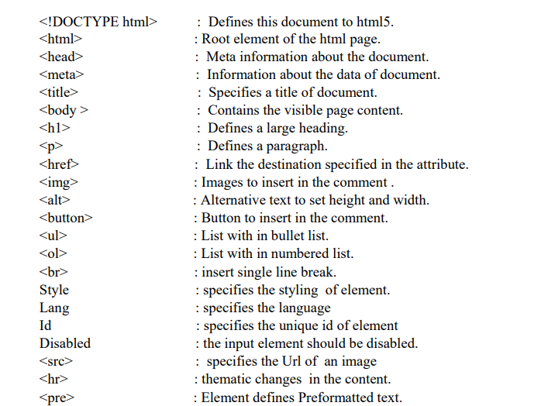
Important Keys

Slide 8
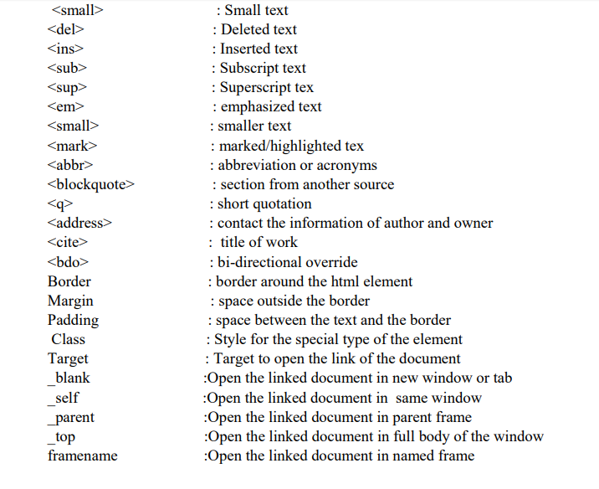

Slide 9
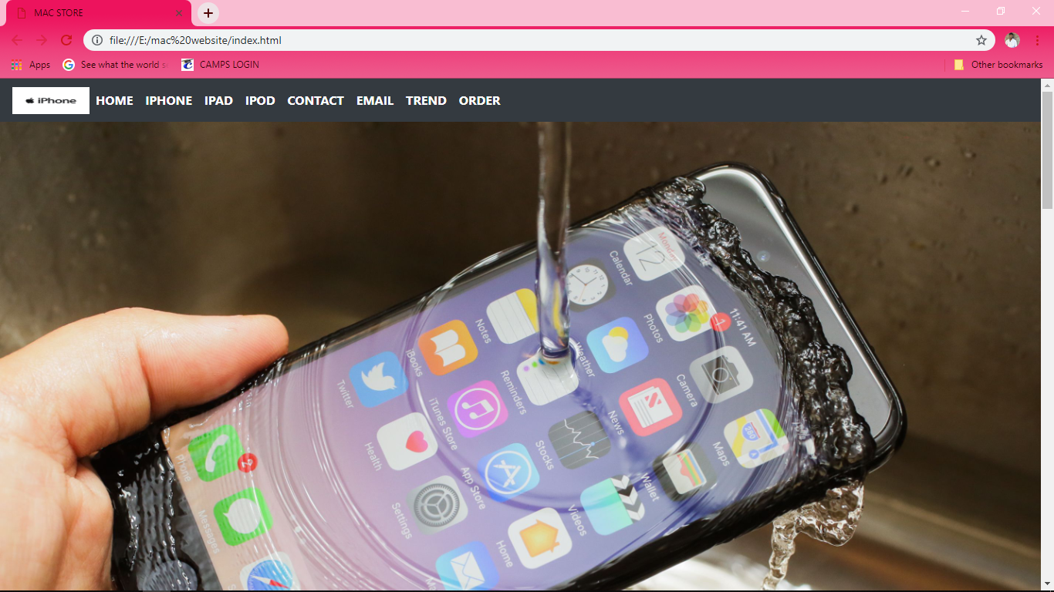
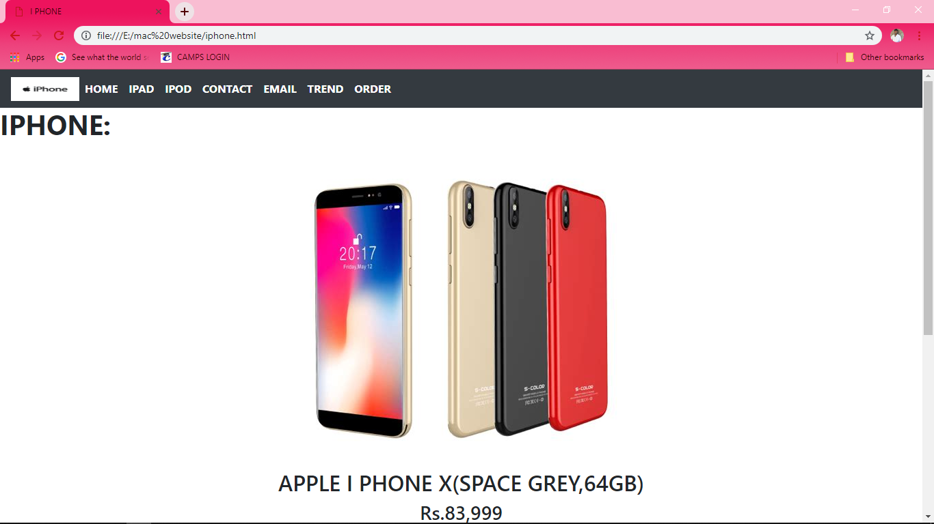
MAC Products

Slide 10
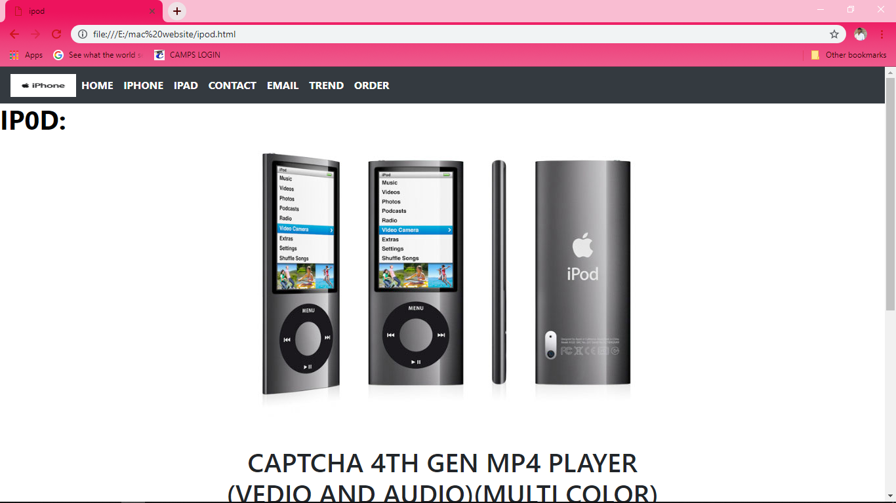
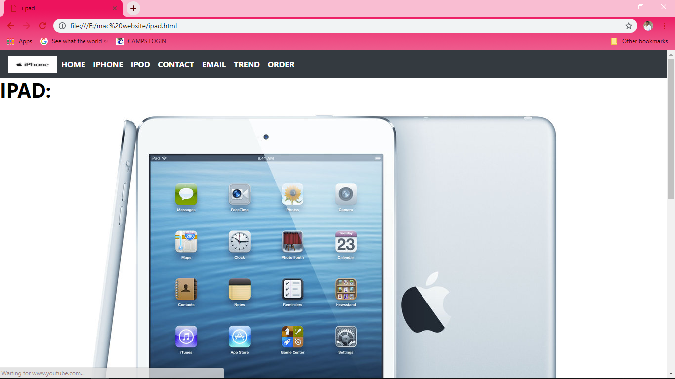

Slide 11
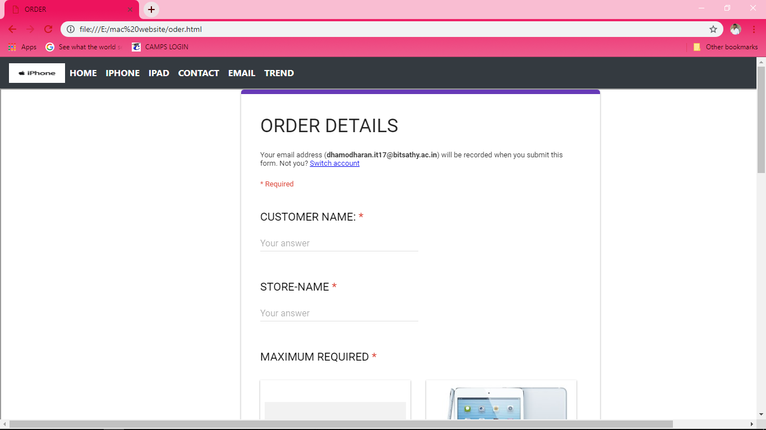

Slide 12
Conclusion
This is a e-commercial project.HTML,BOOTSTRAP and CSS are used which are very useful in creating login and other ordering pages .
The delivered project demonstrates that mac store offers a platform for mac products and selling it to customer in a very conventional manner

Slide 13
THANK YOU

